Slide 1
Artificial Intelligence
Chapter 4: Informed Search and Exploration
AI: Chapter 4: Informed Search and Exploration

Slide 2
Informed (Heuristic) Search Strategies
Informed Search – a strategy that uses problem-specific knowledge beyond the definition of the problem itself
Best-First Search – an algorithm in which a node is selected for expansion based on an evaluation function f(n)
  Traditionally the node with the lowest evaluation function is selected
  Not an accurate name…expanding the best node first would be a straight march to the goal.
  Choose the node that appears to be the best
AI: Chapter 4: Informed Search and Exploration

Slide 3
Best-first search
  Greedy best-first search
  A* search
Heuristics
AI: Chapter 4: Informed Search and Exploration

Slide 4
Best-first search
Idea: use an evaluation function f(n) for each node
  estimate of "desirability"
  Expand most desirable unexpanded node
Implementation:
Order the nodes in fringe in decreasing order of desirability
Special cases:
  Greedy best-first search
  A* search

Slide 5
Informed (Heuristic) Search Strategies
There is a whole family of Best-First Search algorithms with different evaluation functions
  Each has a heuristic function h(n)
h(n) = estimated cost of the cheapest path from node n to a goal node
Example: in route planning the estimate of the cost of the cheapest path might be the straight line distance between two cities
AI: Chapter 4: Informed Search and Exploration

Slide 6
A Quick Review
g(n) = cost from the initial state to the current state n
h(n) = estimated cost of the cheapest path from node n to a goal node
f(n) = evaluation function to select a node for expansion (usually the lowest cost node)
AI: Chapter 4: Informed Search and Exploration

Slide 7
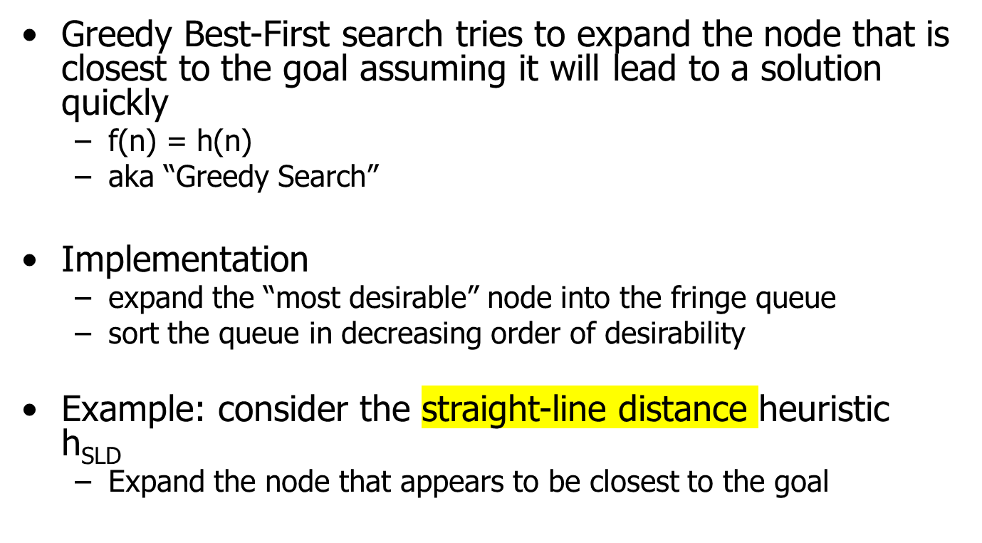
Greedy Best-First Search
AI: Chapter 4: Informed Search and Exploration

Slide 8
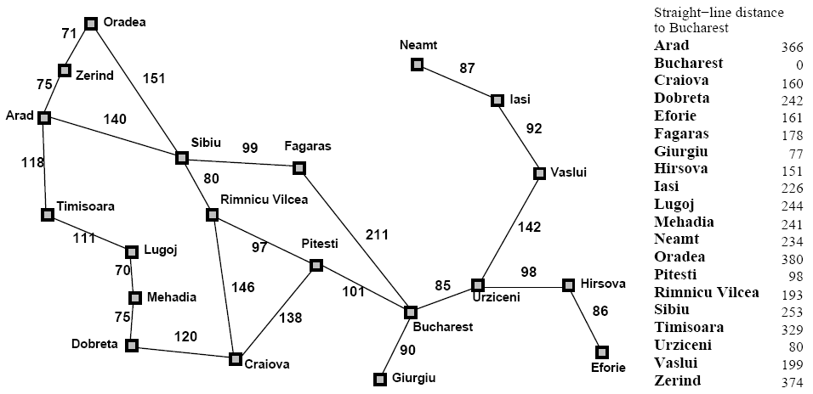
Greedy Best-First Search
AI: Chapter 4: Informed Search and Exploration

Slide 9
Greedy Best-First Search
h_{SLD}(In(Arid)) = 366
Notice that the values of h_{SLD} cannot be computed from the problem itself
It takes some experience to know that h_{SLD} is correlated with actual road distances
  Therefore a useful heuristic
AI: Chapter 4: Informed Search and Exploration

Slide 10

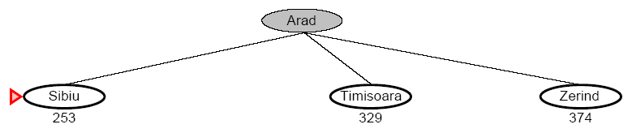
Greedy Best-First Search
AI: Chapter 4: Informed Search and Exploration

Slide 11
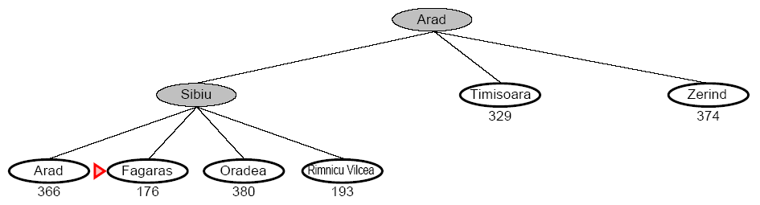
Greedy Best-First Search
AI: Chapter 4: Informed Search and Exploration

Slide 12
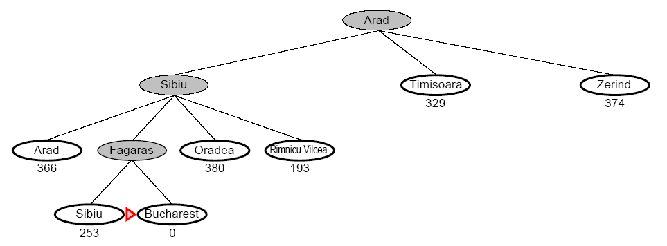
Greedy Best-First Search
AI: Chapter 4: Informed Search and Exploration

Slide 13
Greedy Best-First Search
Complete
  No, GBFS can get stuck in loops (e.g. bouncing back and forth between cities)
Time
  O(b^{m}) but a good heuristic can have dramatic improvement
Space
  O(b^{m}) – keeps all the nodes in memory
Optimal
  No!
AI: Chapter 4: Informed Search and Exploration

Slide 14
A Quick Review - Again
g(n) = cost from the initial state to the current state n
h(n) = estimated cost of the cheapest path from node n to a goal node
f(n) = evaluation function to select a node for expansion (usually the lowest cost node)
AI: Chapter 4: Informed Search and Exploration

Slide 15
A* Search
A* (A star) is the most widely known form of Best-First search
  It evaluates nodes by combining g(n) and h(n)
  f(n) = g(n) + h(n)
  Where
    g(n) = cost so far to reach n
    h(n) = estimated cost to goal from n
    f(n) = estimated total cost of path through n
AI: Chapter 4: Informed Search and Exploration

Slide 16
A* Search
When h(n) = actual cost to goal
  Only nodes in the correct path are expanded
  Optimal solution is found
When h(n) < actual cost to goal
  Additional nodes are expanded
  Optimal solution is found
When h(n) > actual cost to goal
  Optimal solution can be overlooked
AI: Chapter 4: Informed Search and Exploration

Slide 17
A* Search
A* is optimal if it uses an admissible heuristic
  h(n) <= h*(n) the true cost from node n
  if h(n) never overestimates the cost to reach the goal
Example
  h_{SLD} never overestimates the actual road distance
AI: Chapter 4: Informed Search and Exploration

Slide 18
Greedy Best-First Search
AI: Chapter 4: Informed Search and Exploration

Slide 19

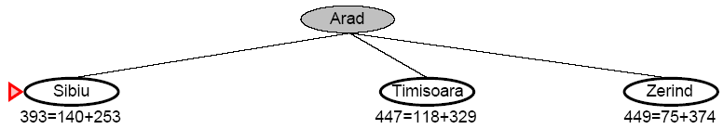
A* Search
AI: Chapter 4: Informed Search and Exploration

Slide 20
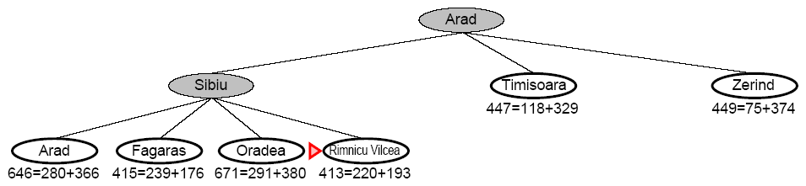
A* Search
AI: Chapter 4: Informed Search and Exploration

Slide 21
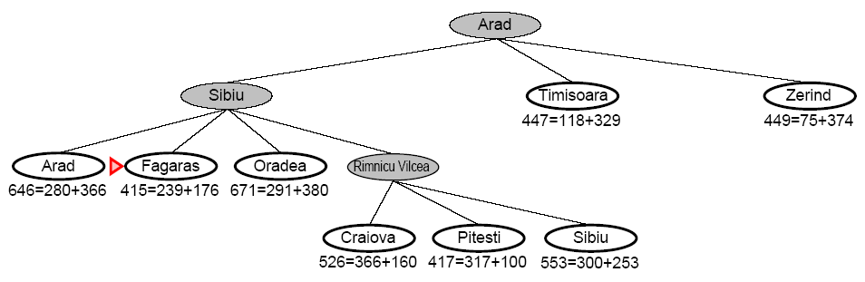
A* Search
AI: Chapter 4: Informed Search and Exploration

Slide 22
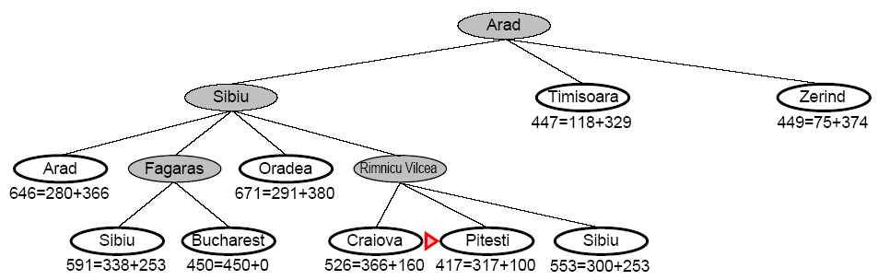
A* Search
AI: Chapter 4: Informed Search and Exploration

Slide 23
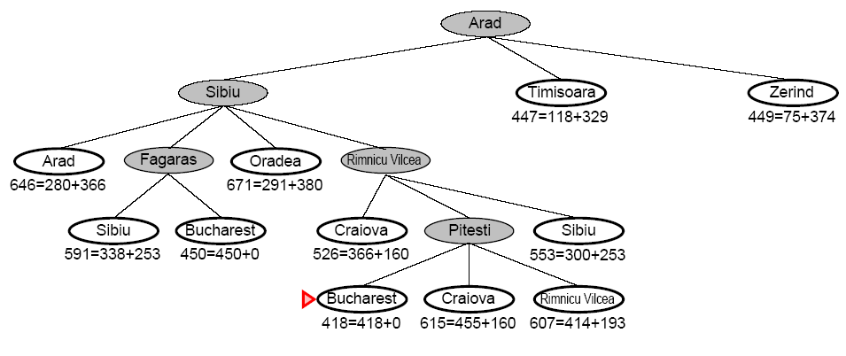
A* Search
AI: Chapter 4: Informed Search and Exploration

Slide 24
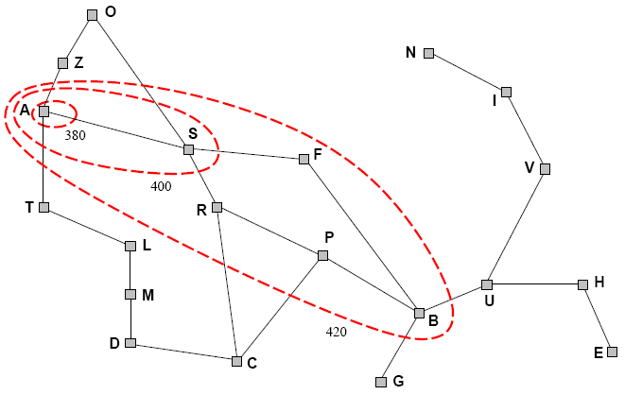
A* Search
A* expands nodes in increasing f value
  Gradually adds f-contours of nodes (like breadth-first search adding layers)
  Contour i has all nodes f=f_{i} where f_{i} < f_{i+1}
AI: Chapter 4: Informed Search and Exploration

Slide 25
A* Search
Complete
  Yes, unless there are infinitely many nodes with f <= f(G)
Time
  Exponential in [relative error of h x length of soln]
  The better the heuristic, the better the time
    Best case h is perfect, O(d)
    Worst case h = 0, O(b^{d}) same as BFS
Space
  Keeps all nodes in memory and save in case of repetition
  This is O(b^{d}) or worse
  A* usually runs out of space before it runs out of time
Optimal
  Yes, cannot expand f_{i+1} unless f_{i} is finished
AI: Chapter 4: Informed Search and Exploration

Slide 26
Memory-Bounded Heuristic Search
Iterative Deepening A* (IDA*)
  Similar to Iterative Deepening Search, but cut off at (g(n)+h(n)) > max instead of depth > max
  At each iteration, cutoff is the first f-cost that exceeds the cost of the node at the previous iteration
RBFS – see text figures 4.5 and 4.6
Simple Memory Bounded A* (SMA*)
  Set max to some memory bound
  If the memory is full, to add a node drop the worst (g+h) node that is already stored
  Expands newest best leaf, deletes oldest worst leaf
AI: Chapter 4: Informed Search and Exploration

Slide 27
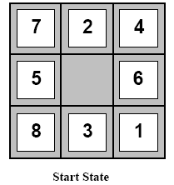
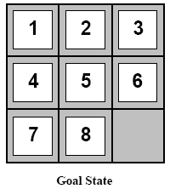
Heuristic Functions
Example: 8-Puzzle
  Average solution cost for a random puzzle is 22 moves
  Branching factor is about 3
    Empty tile in the middle -> four moves
    Empty tile on the edge -> three moves
    Empty tile in corner -> two moves
  3²² is approx 3.1e10
    Get rid of repeated states
    181440 distinct states
AI: Chapter 4: Informed Search and Exploration

Slide 28
Heuristic Functions
To use A* a heuristic function must be used that never overestimates the number of steps to the goal
h1=the number of misplaced tiles
h2=the sum of the Manhattan distances of the tiles from their goal positions
AI: Chapter 4: Informed Search and Exploration

Slide 29
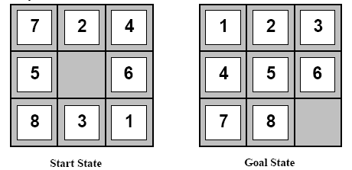
Heuristic Functions
h1 = 7
h2 = 4+0+3+3+1+0+2+1 = 14
AI: Chapter 4: Informed Search and Exploration

Slide 30
Dominance
If h2(n) > h1(n) for all n (both admissible) then h2(n) dominates h1(n) and is better for the search
Take a look at figure 4.8!
AI: Chapter 4: Informed Search and Exploration

Slide 31
Relaxed Problems
A Relaxed Problem is a problem with fewer restrictions on the actions
  The cost of an optimal solution to a relaxed problem is an admissible heuristic for the original problem
Key point: The optimal solution of a relaxed problem is no greater than the optimal solution of the real problem
AI: Chapter 4: Informed Search and Exploration

Slide 32
Relaxed Problems
Example: 8-puzzle
  Consider only getting tiles 1, 2, 3, and 4 into place
  If the rules are relaxed such that a tile can move anywhere then h1(n) gives the shortest solution
  If the rules are relaxed such that a tile can move to any adjacent square then h2(n) gives the shortest solution
AI: Chapter 4: Informed Search and Exploration

Slide 33
Relaxed Problems
Store sub-problem solutions in a database
  # patterns is much smaller than the search space
  Generate database by working backwards from the solution
  If multiple sub-problems apply, take the max
  If multiple disjoint sub-problems apply, heuristics can be added
AI: Chapter 4: Informed Search and Exploration

Slide 34
Learning Heuristics From Experience
h(n) is an estimate cost of the solution beginning at state n
How can an agent construct such a function?
Experience!
  Have the agent solve many instances of the problem and store the actual cost of h(n) at some state n
  Learn from the features of a state that are relevant to the solution, rather than the state itself
    Generate “many” states with a given feature and determine the average distance
    Combine the information from multiple features
      h(n) = c(1)*x1(n) + c(2)*x2(n) + … where x1, x2, … are features
AI: Chapter 4: Informed Search and Exploration

Slide 35
Optimization Problems
Instead of considering the whole state space, consider only the current state
Limits necessary memory; paths not retained
Amenable to large or continuous (infinite) state spaces where exhaustive search algorithms are not possible
Local search algorithms can’t backtrack
AI: Chapter 4: Informed Search and Exploration

Slide 36
Local Search Algorithms
They are useful for solving optimization problems
  Aim is to find a best state according to an objective function
Many optimization problems do not fit the standard search model outlined in chapter 3
  E.g. There is no goal test or path cost in Darwinian evolution
State space landscape
AI: Chapter 4: Informed Search and Exploration

Slide 37
Optimization Problems
Given measure of goodness (of fit)
  Find optimal parameters (e.g correspondences)
  That maximize goodness measure (or minimize badness measure)
Optimization techniques
  Direct (closed-form)
  Search (generate-test)
  Heuristic search (e.g Hill Climbing)
  Genetic Algorithm
AI: Chapter 4: Informed Search and Exploration

Slide 38
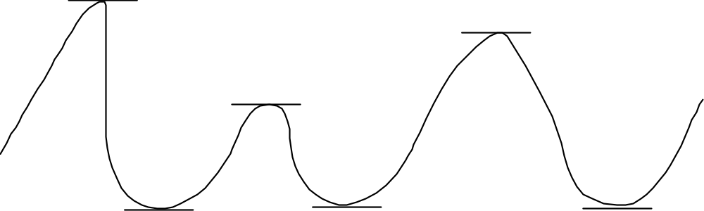
Direct Optimization
The slope of a function at the maximum or minimum is 0
  Function is neither growing nor shrinking
  True at global, but also local extreme points
Find where the slope is zero and you find extrema!
(If you have the equation, use calculus (first derivative=0)
AI: Chapter 4: Informed Search and Exploration

Slide 39
Hill Climbing
Consider all possible successors as “one step” from the current state on the landscape.
At each iteration, go to
  The best successor (steepest ascent)
  Any uphill move (first choice)
  Any uphill move but steeper is more probable (stochastic)
All variations get stuck at local maxima
AI: Chapter 4: Informed Search and Exploration

Slide 40
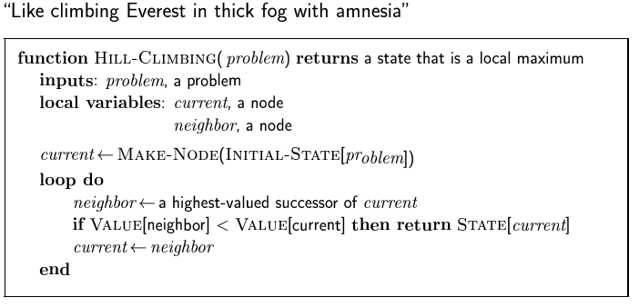
Hill Climbing
AI: Chapter 4: Informed Search and Exploration

Slide 41
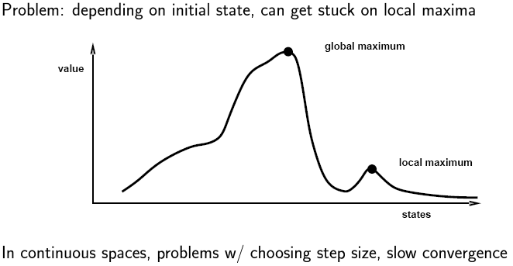
Hill Climbing
AI: Chapter 4: Informed Search and Exploration

Slide 42
Hill Climbing
Local maxima = no uphill step
  Algorithms on previous slide fail (not complete)
  Allow “random restart” which is complete, but might take a very long time
Plateau = all steps equal (flat or shoulder)
  Must move to equal state to make progress, but no indication of the correct direction
Ridge = narrow path of maxima, but might have to go down to go up (e.g. diagonal ridge in 4-direction space)
AI: Chapter 4: Informed Search and Exploration

Slide 43
Simulated Annealing
Idea: Escape local maxima by allowing some “bad” moves
  But gradually decreasing their frequency
Algorithm is randomized:
  Take a step if random number is less than a value based on both the objective function and the Temperature
When Temperature is high, chance of going toward a higher value of optimization function J(x) is greater
Note higher dimension: “perturb parameter vector” vs. “look at next and previous value”
AI: Chapter 4: Informed Search and Exploration

Slide 44
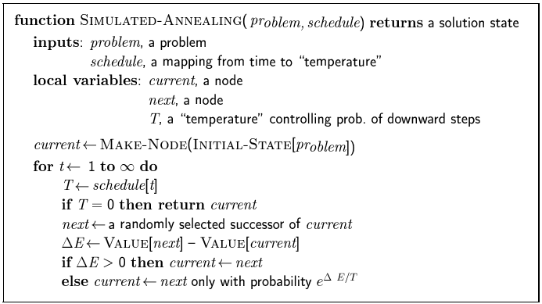
Simulated Annealing
AI: Chapter 4: Informed Search and Exploration

Slide 45
Genetic Algorithms
Quicker but randomized searching for an optimal parameter vector
Operations
  Crossover (2 parents -> 2 children)
  Mutation (one bit)
Basic structure
  Create population
  Perform crossover & mutation (on fittest)
  Keep only fittest children
AI: Chapter 4: Informed Search and Exploration

Slide 46
Genetic Algorithms
Children carry parts of their parents’ data
Only “good” parents can reproduce
  Children are at least as “good” as parents?
    No, but “worse” children don’t last long
Large population allows many “current points” in search
  Can consider several regions (watersheds) at once
AI: Chapter 4: Informed Search and Exploration

Slide 47
Genetic Algorithms
Representation
  Children (after crossover) should be similar to parent, not random
  Binary representation of numbers isn’t good - what happens when you crossover in the middle of a number?
  Need “reasonable” breakpoints for crossover (e.g. between R, xcenter and ycenter but not within them)
“Cover”
  Population should be large enough to “cover” the range of possibilities
  Information shouldn’t be lost too soon
  Mutation helps with this issue
AI: Chapter 4: Informed Search and Exploration

Slide 48
Experimenting With GAs
Be sure you have a reasonable “goodness” criterion
Choose a good representation (including methods for crossover and mutation)
Generate a sufficiently random, large enough population
Run the algorithm “long enough”
Find the “winners” among the population
Variations: multiple populations, keeping vs. not keeping parents, “immigration / emigration”, mutation rate, etc.
AI: Chapter 4: Informed Search and Exploration

